Slide 1
**** COMMODORE 64 BASIC V2 ****
64K RAM SYSTEM 38911 BASIC BYTES FREE
READY.
Retro AI
AI algorithms on the Commodore 64
and how they apply to modern AI
Rachel Appel
rachel.appel@jetbrains.com

Slide 2
Delete this slide
Things to point out for each program
What kind of AI is it (expert sys, nlp, etc..)
The techniques in it
-where it applies today, types of programs, specific ones
-How it’s been affected by a lack of storage vs storage now, as well as with slow CPU/speed vs now, also cloud.
-for cpu, it’s about the time issue. Given enough time, sure a c64 can solve the problem. Or given enough CPU power.

Slide 3
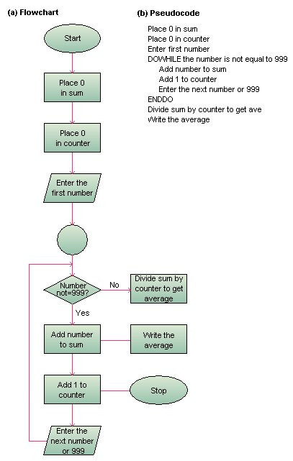
Start
Define AI and set context
3 main areas: NLP Expert systems Problem solving
3 techniques: Algorithmic heuristic pattern
Talk about early programs
Evolution not revolution
AI uses throughout the decades (autocomplete, customer service by phone pushbutton, internet chat help, manufacturing,
Sample
Sample
Sample
Sample 20 Questions

Slide 4
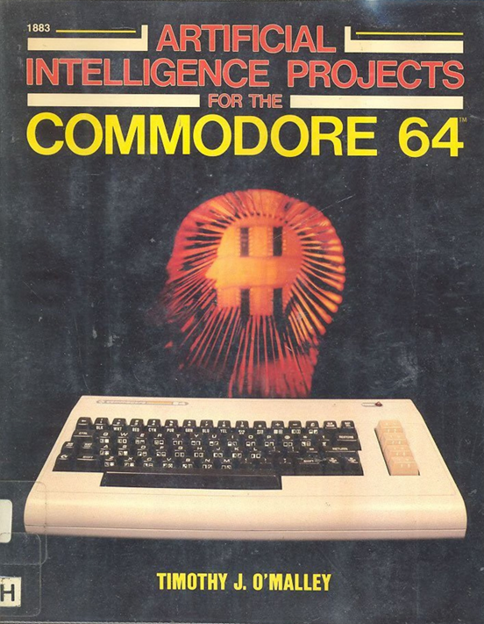
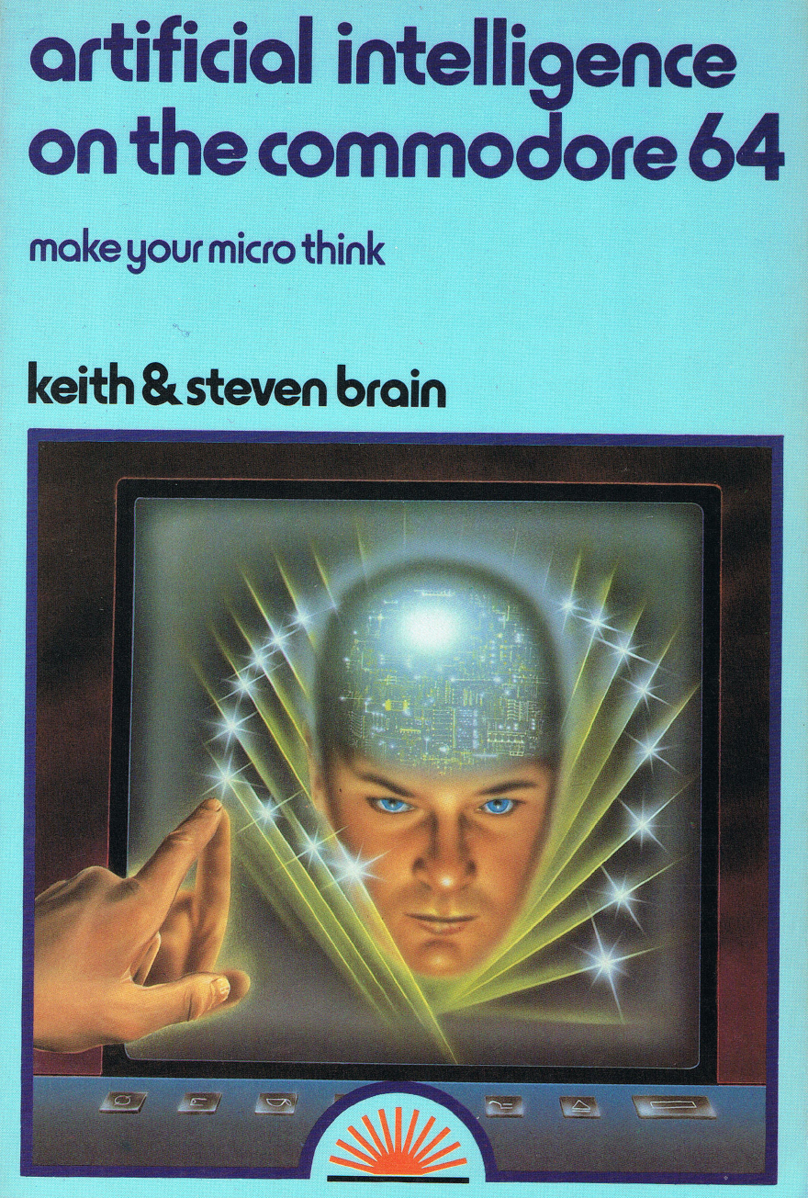

Slide 5
“Artificial intelligence is the attempt to set machines to perform processing abilities normally associated only with cognitive human thought. It is artificial in the sense that it is a manufactured technique and may not have the same basis as human intelligence.”
“What is important is that the results of human and artificial intelligence are highly similar.”
“Artificial Intelligence is really more than that, though. It is the ability of the computer to better utilize the information that it contains.”

Slide 6



Natural Language Processing
Problem-solving Systems
Expert Systems

Slide 7
Algorithm:
“A process or set of rules to be followed in calculations or other problem-solving operations, especially by a computer.”
-Oxford Languages Dictionary

Slide 8
AI techniques:
Tree search (recursion)
Algorithmic (rule) Method
Heuristic method
Pattern searching
More…

Slide 9






The AI Effect

Slide 10
Towers of Hanoi
Notes:
Recursion through tree nodes
Recursive Problem Solving
Problem Decomposition: Breaking down complex tasks into smaller, manageable sub-tasks. This principle is fundamental in both planning problems and hierarchical task networks (HTNs) in AI.
Search Algorithms: Recursion is often used in depth-first search (DFS) algorithms, which are pivotal in traversing state spaces in AI.
Divide and conquer; parallel processing
State Space Representation: In the Towers of Hanoi problem, each configuration of disks on pegs represents a "state“
State Space Search: Many AI problems, including those solved by LLMs, can be framed as searching through a state space. Techniques such as breadth-first search (BFS), DFS, and A* search are grounded in understanding states and transitions between them.
Constraint Satisfaction Problems (CSPs)**: Representing problems as sets of variable constraints is similar to representing the state and rules of disk moves in the Towers of Hanoi.
Scalability Analysis: In AI, understanding how problems scale and managing computational resources accordingly is crucial. Techniques from the analysis of the Towers of Hanoi help in modeling and expectation management of algorithm performance.
Exploration vs Exploitation: Balancing exploration and exploitation strategies is foundational in reinforcement learning, where the growth of possible states must be managed effectively.
Cognitive and Learning Models The cognitive processes involved in solving Towers of Hanoi are similar to those used in certain AI and learning models: - Hierarchical Reinforcement Learning (HRL): Tasks are broken down into smaller sub-tasks, akin to moving smaller stacks of disks before larger ones. - Skill Acquisition and Transfer Learning: The process of learning a recursive task and generalizing it to solve larger instances can be mapped to how models learn and transfer knowledge to new domains. ### Applications in LLMs: Large Language Models (LLMs) such as GPT-3 leverage these concepts predominantly in their training and inference stages: - Understanding and generating structured text: Whether decomposing sentences or constructing logical sequences, LLMs utilize principles of recursion and hierarchical structuring. - Efficient computation: Techniques like memoization can enhance the efficiency of generating responses by caching previous computations. While the exact recursive algorithm of Towers of Hanoi may not be directly used, the problem-solving principles from it continue to inspire and inform advanced AI methods and applications.

Slide 11
The Knight’s Tour
Notes:
Expert system
Depth-first search
Breadth-first search
Backtracking
Warnsdorff’s algorithm
The problem can be solved using several different algorithms, including depth-first search, breadth-first search, and backtracking. The most famous algorithm used to solve the Knight's Tour problem is Warnsdorff's algorithm, which is based on the principle that the knight should always move to the square with the least number of available moves.
This is on the C64 an expert system where all the correct moves (the expertise) are in the data

Slide 12
ELIZA like program
Notes:
Natural language processing

Slide 13
Tic-tac Toe
Notes:
Natural language processing

Slide 14
20 Questions
Notes:
Natural language processing

Slide 15
10 PRINT "ANIMAL, MINERAL, VEGETABLE - 20 QUESTIONS"
20 PRINT "THINK OF AN OBJECT AND I WILL TRY TO GUESS IT."
30 PRINT "ANSWER MY QUESTIONS WITH YES OR NO."
40 D$="ANIMAL"
50 E$="MINERAL"
60 F$="VEGETABLE"
70 G(1)=1:G(2)=0:G(3)=0
80 DIM Q$(20), A$(20), B$(20)
90 Q$(1)="IS IT AN ANIMAL, MINERAL OR VEGETABLE?"
100 A$(1)="ANIMAL"
110 B$(1)="MINERAL"
120 REM QUESTIONS FOR ANIMAL
130 Q$(2)="DOES IT LIVE UNDERWATER?"
140 A$(2)="FISH"
150 B$(2)="DOG"
160 REM QUESTIONS FOR MINERAL
170 Q$(3)="IS IT A METAL?"
180 A$(3)="GOLD"
190 B$(3)="ROCK"
200 REM QUESTIONS FOR VEGETABLE
210 Q$(4)="IS IT A FRUIT?"
220 A$(4)="APPLE"
230 B$(4)="CARROT"
240 REM VARIABLES
250 N=1 : Q=1
260 PRINT Q$(1)
270 INPUT A$: IF A$="ANIMAL" THEN N=2 : GOSUB 300
280 IF A$="MINERAL" THEN N=3 : Q=3 : GOSUB 300
290 IF A$="VEGETABLE" THEN N=4 : Q=4 : GOSUB 300
300 FOR I=2 TO 20
310 PRINT Q$(Q)
320 INPUT A$
330 IF A$="YES" THEN NEXTQ=Q+1 ELSE NEXTQ=Q+2
340 IF NEXTQ>20 THEN PRINT "I GIVE UP. PLEASE TELL ME WHAT IT WAS.": INPUT NEWITEM$: PRINT "THANK YOU! I WILL REMEMBER THAT.": Q$(Q)= "IS IT " + NEWITEM$ + " ? ": IF A$ = "YES" THEN A$(N)= NEWITEM$ ELSE B$(N)=NEWITEM$: GOSUB 300
350 PRINT "IT IS A ";A$(NEXTQ)
360 INPUT A$: IF A$="YES" THEN PRINT "I GUESSED IT!" ELSE PRINT "OH NO! I WILL LEARN FROM THIS."
370 N=NEXTQ
380 GOTO 300
390 NEXT I
400 END

Slide 16
THANK YOU!
Rachel Appel
rachel@rachelappel.com
The C64 in the 1980’s
Notes:
Natural language processing

